Slide 1

What are REST Web Services?
Request
Client
(Service Consumer)
Server
(Service Provider)
Response

Slide 2




What are REST Web Services?

Slide 3
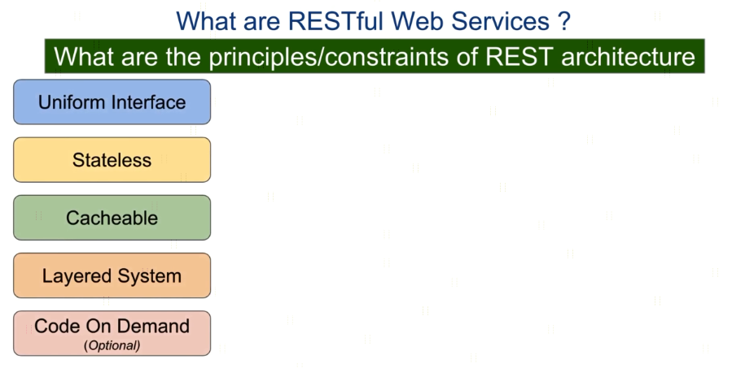

What are REST Web Services?

Slide 4
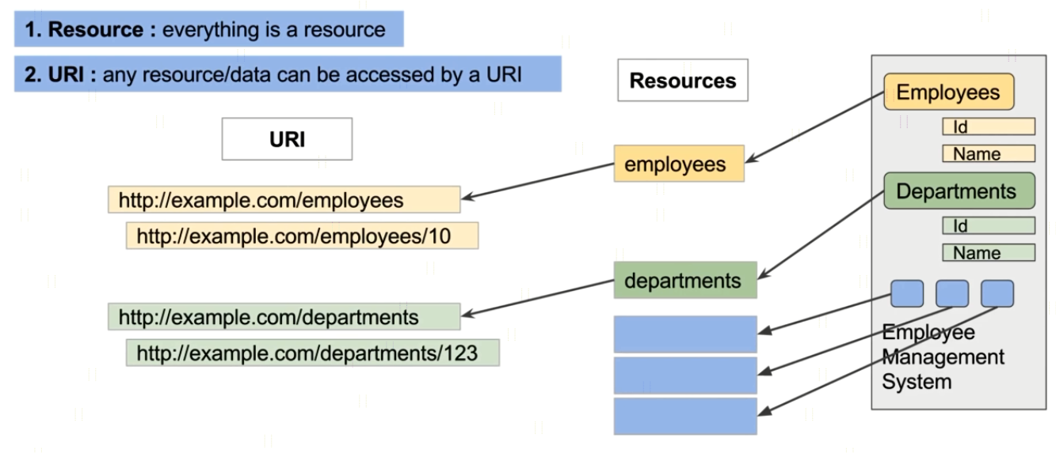
What are REST Web Services?

Slide 5

What are REST Web Services?

Slide 6
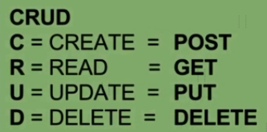
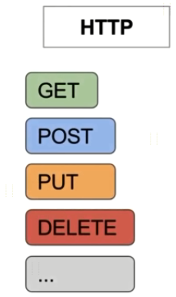
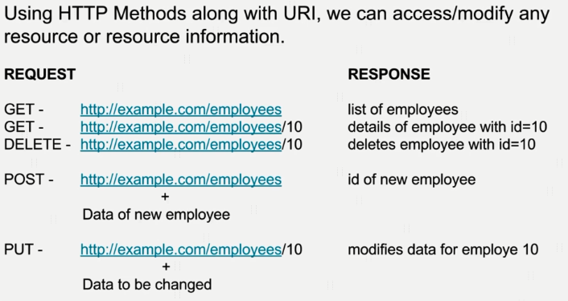
What are REST Web Services?

Slide 7


What are REST Web Services?

Slide 8
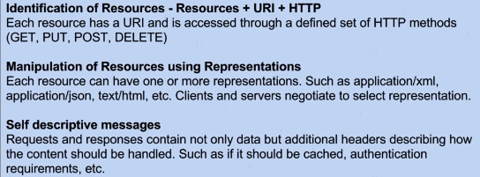
What are REST WebServices?

Slide 9
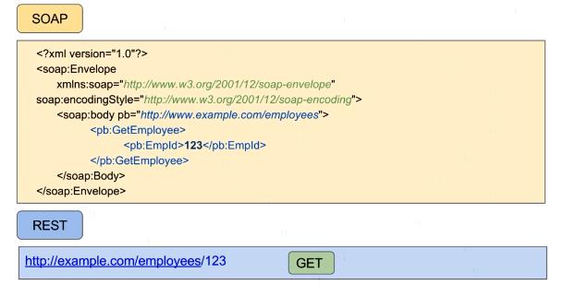
What are REST WebServices?

Slide 10

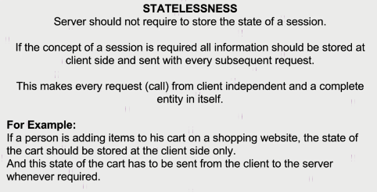
What are REST WebServices?
Request
Client
(Service Consumer)
Server
(Service Provider)
Response

Slide 11
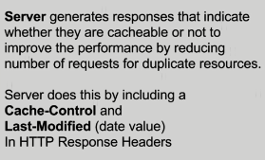
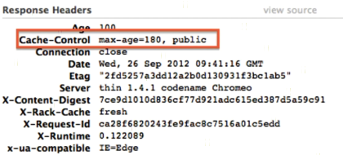

What are REST WebServices?
Request
Client
(Service Consumer)
Server
(Service Provider)
Response

Slide 12
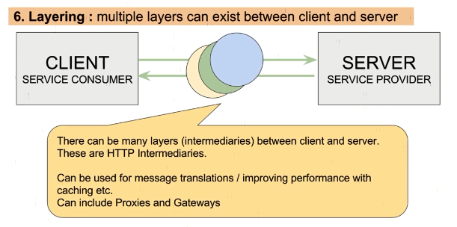
What are REST WebServices?

Slide 13




What are REST WebServices?

Slide 14


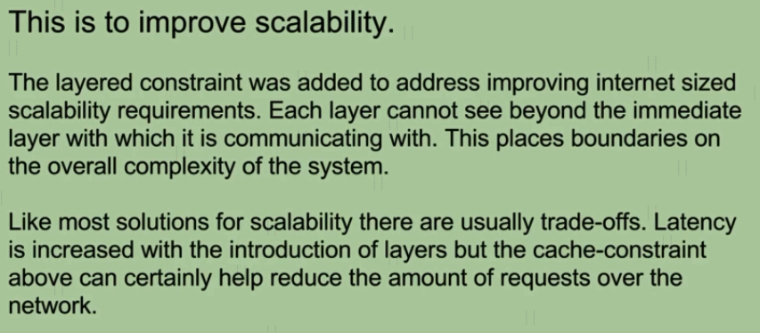
What are REST WebServices?

Slide 15
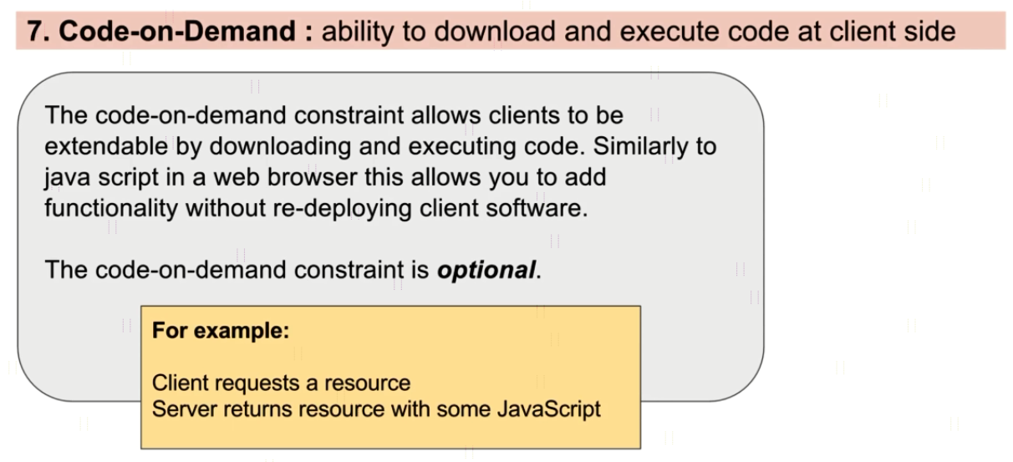
What are REST WebServices?

Slide 16
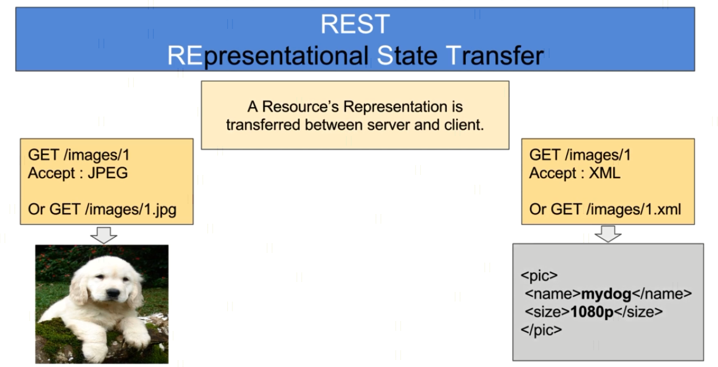
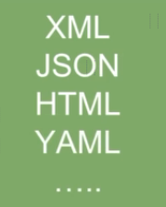
What are REST WebServices?

Slide 17
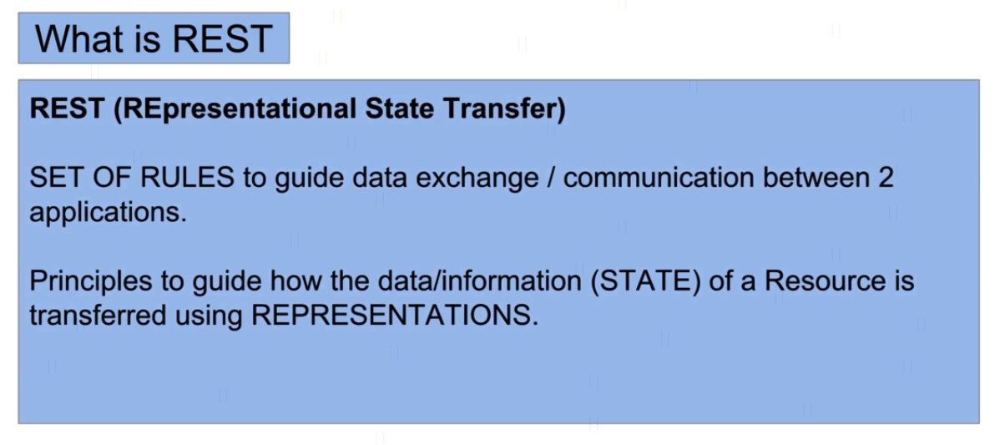
HTTP Message Structure

